Slide 1

BOX OFFICE REVENUE PREDICTION
BY
satvik – 210962042
Neerajh - 210962076

Slide 2

INTRODUCTION
Accurate prediction of box office revenue is a critical facet of the film industry, influencing strategic decisions for filmmakers, studios, and investors. In recent times, the integration of machine learning techniques has emerged as a powerful tool for enhancing the precision and efficacy of box office revenue prediction. This study explores the film industry's complexities, aiming to predict box office revenue using machine learning algorithms like linear regression, random forest, XGBoost, and SVM. With a comprehensive dataset, rigorous preprocessing, and feature engineering, the research evaluates the models' efficacy in predicting revenue using metrics like mean absolute error and root mean squared error.

Slide 3

OBJECTIVES
Ensure the dataset's integrity by removing irrelevant features and addressing missing values.
Explore a diverse set of machine learning models (XGBoost, Linear Regression, SVR, Random Forest) to identify the most effective model for predicting.
Seamlessly incorporate categorical variables ('MPAA' ratings, 'distributor') into machine learning models through categorical encoding methodologies, ensuring model compatibility.
Systematically evaluate model performance using established metrics (MAE, MSE, RMSE), providing a quantitative assessment of the predictive capabilities of the trained models.
Aim to achieve best possible prediction with least possible error

Slide 4
LITERATURE REVIEW The provided list of papers focuses on box office prediction using various machine learning and sentiment analysis techniques :
Chen and Wang (2017):
Hybrid method: ML + sentiment analysis.
Key: Improved box office prediction accuracy.
Wu, Li, and Zhu (2016):
Box office prediction: Neural networks + ensemble learning.
Key: Enhanced prediction performance.
Wang, Li, and Li (2016):
Hybrid: ML + sentiment analysis.
Key: Improved prediction accuracy.
Liu, Li, and Zhang (2016):
Novel: Ensemble learning + sentiment analysis.
Key: Improved prediction, context understanding.
Zhang, Gao, and Huang (2015):
Box office prediction: ML + sentiment analysis.
Key: Application of ML, sentiment analysis.
Lee, Park, and Kim (2014):
Hybrid: ML + social media mining.
Key: Integration for enhanced accuracy.
Zhang and Li (2014):
New method: ML + sentiment analysis.
Key: Novel approach with sentiment analysis.
Zhang and Chen (2013):
Novel method: ML + sentiment analysis.
Key: Introduction of a new method.
Li and Liu (2012):
Ensemble learning + sentiment analysis.
Key: Improved prediction accuracy.
Zhang and Wang (2011):
Box office prediction: ML + sentiment analysis.
Key: Application of ML, sentiment analysis.

Slide 5

METHODOLOGY
The steps involved in this project are:
Selecting the dataset and splitting into training and testing data
Perform data cleaning , exploratory data analysis and feature selection
Perform model development
Calculate the required metrics and analyse the results

Slide 6
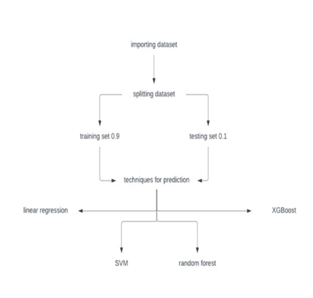
The dataset utilized in this study comprises data of various movies and these movies majorly comprise of Hollywood films.
For the experiments conducted in this paper, the dataset. Consists of 2694 movies and the attributes involved are: ‘title’ , ‘ domestic revenue’ , ‘world revenue’ , ‘distributor’ , ‘opening revenue’ , ‘opening theatres’ , ‘budget’ , ‘MPAA’ , ‘genre’ and ‘ release days ‘.
These attributes serve as the foundation for predicting the box office revenue, enabling a comprehensive analysis of the relationships between these movie attributes and the predicted collection at the box office.
The pre-processed dataset is divided into training and testing sets using a 90:10 ratio. The training set (90%) will be used for model training, while the testing set (10%) will evaluate model performance.

Slide 7
Handling Null Values:
Columns 'budget' and 'MPAA' are dropped due to null values. Missing values in categorical columns ('MPAA' and 'genres') are filled with the mode of each respective column. Rows with null values are dropped from the dataset.
Data Type Conversion:
Columns related to revenue ('domestic revenue', 'opening_theaters', 'release days') are cleaned by removing commas and converting them to numeric types. Null values in these columns are converted to float types using the convert_dtypes method.
Log Transformation:
Logarithmic transformation (base 10) is applied to numeric columns ('domestic revenue', 'opening_theaters', 'release_days’).
Text Data Transformation:
The 'genres' column is transformed into binary features using CountVectorizer, creating a matrix of binary values for each genre.
Removing Sparse Columns:
Columns with more than 95% of values as zero are removed, to reduce sparsity in the dataset.
Categorical Data Visualization:
The 'MPAA' column, assumed to be categorical, is visualized using a count plot.
Numeric Data Visualization:
Distributions and box plots are created for numeric features ('domestic_revenue', 'opening_theaters', 'release_days’).
Correlation Analysis:
A heatmap or correlation matrix is generated to visualize correlations between features. Features with correlations greater than 0.8 are highlighted.

Slide 8
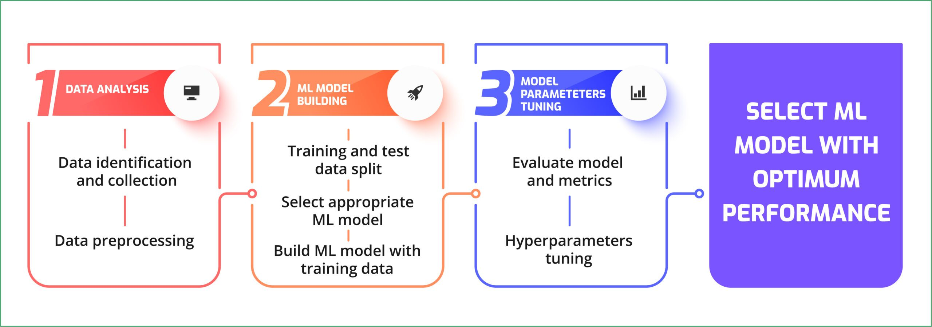
The model development process involved a series of steps aimed at identifying the most effective machine learning algorithm for predicting the box office revenue.
The algorithms used in this implementation are:
XGBoost implementation:
XGBoost is a powerful and efficient gradient boosting algorithm that constructs an ensemble of decision trees to optimize and minimize a specified loss function, widely used for classification and regression tasks
Linear regression implementation:
Linear Regression, a classical regression technique, was employed to model the relationship between features and the target variable (domestic revenue)
Support vector machine implementation:
It a supervised machine learning algorithm that identifies an optimal hyperplane to separate different classes, maximizing the margin between them in the feature space
Random forest implementation:
An ensemble of decision trees for improved predictive performance. It was implemented to capture complex relationships in the data
Throughout the process, the dataset underwent various preprocessing steps, including handling missing values, encoding categorical variables, and normalizing numerical features. Exploratory Data Analysis (EDA) techniques such as visualizations were employed to understand the distribution and characteristics of key features.
Performance metrics such as Mean Absolute Error (MAE), Mean Squared Error (MSE), and Root Mean Squared Error (RMSE) were computed to assess the accuracy of each model on both the training and validation sets. The results were visualized using scatterplots, providing a comparison between the actual and predicted values for each model.

Slide 9
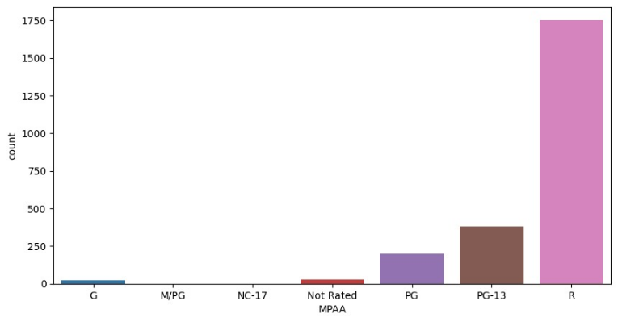
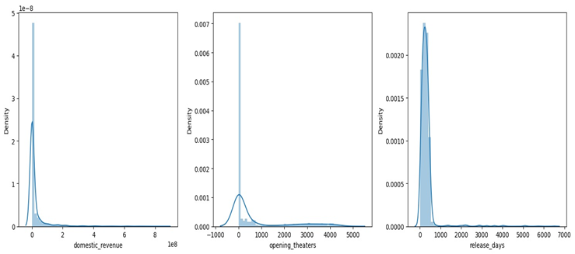
RESULTS – DISCUSSION AND ANALYSIS
Initially we make a count plot for MPAA that shows the count of observations in each category of a categorical variable.(this is done to visualize the distribution of movie ratings.)
Three subplots show the distribution of 'domestic_revenue,' 'opening_theaters,' and 'release_days.' The plots help understand the spread and central tendency of these features.

Slide 10
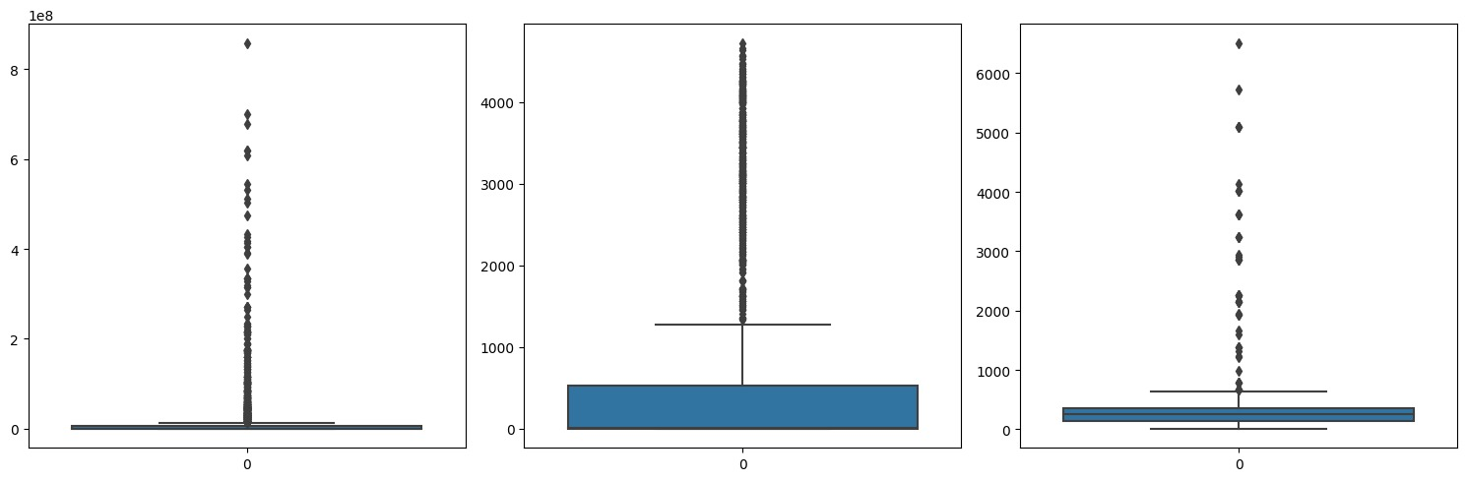
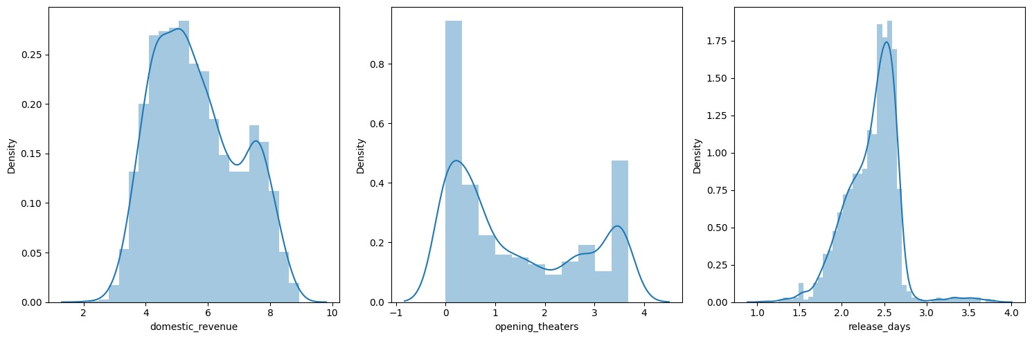
Three subplots display box plots for 'domestic_revenue,' 'opening_theaters,' and 'release_days.' Outliers and the interquartile range (IQR) can be observed.
The distribution plots show the effect of log transformation on 'domestic_revenue,' 'opening_theaters,' and 'release_days.' Log transformation is applied to handle right-skewed distributions.

Slide 11
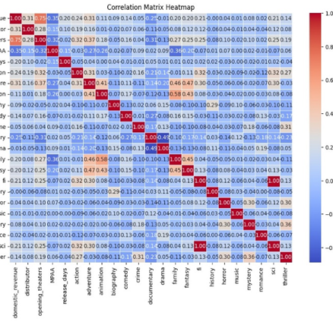
We calculate the correlation matrix and plot the heatmap and perform feature selection. The purpose of this heatmap is to visualize highly correlated variables in the dataset. A threshold of 0.8 is set and we use this to identify potential required relationships in the dataset.

Slide 12

The metrics used for the analysis of results are training error and validation mean absolute error(MAE), mean square error(MSE) and root mean square error(RMSE).
Training Error:
The training error is the error or loss incurred by the model on the training dataset.
It represents how well the model fits the training data.
The model is trained to minimize this error during the training process.
Training error is essentially a measure of how well the model has learned the patterns in the training data.
Validation Error:
The validation error is the error or loss incurred by the model on a separate dataset that was not used during training, typically referred to as the validation dataset.
It provides an estimate of how well the model is likely to perform on new, unseen data.
Validation error helps assess the generalization ability of the model to new data.

Slide 13
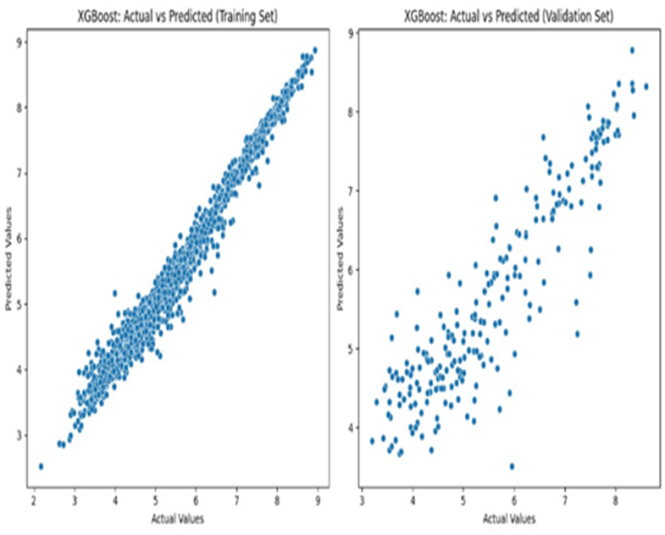
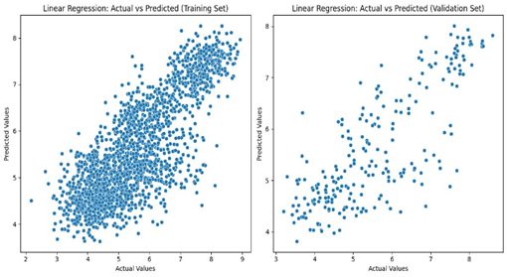
XGBoost (Extreme Gradient Boosting) is implemented for regression using the XGBRegressor from the XGBoost library.
The MAE, MSE and RMSE are as follows for the XGBoost implementation:
Training MAE: 0.1311083568380254
Training MSE: 0.03806963424800606
Training RMSE: 0.19511441322466688
----
Validation MAE: 0.4340367343796249
Validation MSE: 0.3524018681116089
Validation RMSE: 0.5936344566411293
The linear regression model aims to find a linear relationship between the features and the target variable, making predictions based on this linear equation.
The MAE, MSE and RMSE are as follows for the linear regression implementation:
Training MAE: 0.6346133108283997
Training MSE: 0.6532060615846579
Training RMSE: 0.8082116440541165
----
Validation MAE: 0.6561183171407359
Validation MSE: 0.6996843779208017
Validation RMSE: 0.8364713849981968

Slide 14
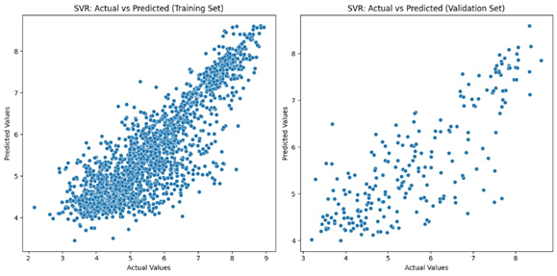
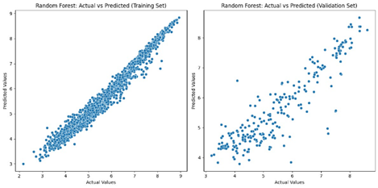
The SVR model uses support vectors to find a hyperplane that best represents the relationship between the features and the target variable in a regression context.
The MAE, MSE and RMSE are as follows for the SVM implementation:
Training MAE : 0.4838016293845128
Training MSE : 0.465866368865944
Training RMSE : 0.6825440417042288
----
Validation MAE : 0.6168029738889681
Validation MSE : 0.6796360371422265
Validation RMSE : 0.824400410687808
The Random Forest model, with its ensemble of decision trees, is applied to regression tasks, providing robust predictions and handling non-linear relationships in the data.
The MAE, MSE and RMSE are as follows for random forest implementation:
Training MAE: 0.15990931384937995
Training MSE : 0.05047131463665959
Training RMSE : 0.22465821738066824
----------
Validation MAE: 0.45072446143847467
Validation MSE : 0.3862920985432429
Validation RMSE : 0.6215240128452343

Slide 15
Now let us compare the results of all the four implementations and analyze the error metrics of the four algorithms
As we can see from the previous table:
We have the least validation error for XGBoost implementation, so we can say that among the four, it is the most efficient for predicting the box office revenue.
We have the highest validation error for Linear Regression implementation, so we can say that among the four, it is the least efficient for predicting the box office revenue.
 | TRAINING MAE , MSE , RMSE | VALIDATION MAE , MSE , RMSE
XGBoost | 0.1311,0.03,0.195 | 0.43,0.35,0.59
Linear regression | 0.63,0.65,0.80 | 0.65,0.7,0.83
SVM | 0.48,0.46,0.68 | 0.61,0.67,0.82
Random Forest | 0.16,0.05,0.22 | 0.45,0.38,0.62

Slide 16
CONCLUSION
The project demonstrates the application of three regression models—Linear Regression, Support Vector Machine (SVR), and Random Forest, along with the powerful XGBoost algorithm, to predict domestic movie revenue based on various features. The dataset undergoes preprocessing steps, including handling missing values, encoding categorical variables, and feature scaling.
Linear Regression -- being a simple and interpretable model, provides baseline predictions
SVR -- a non-linear regression model, is employed to capture complex relationships in the data.
Random Forest -- an ensemble of decision trees, is introduced for regression.
XGBoost -- a state-of-the-art gradient boosting algorithm, demonstrates superior performance.
The results on training and validation sets, evaluated using Mean Absolute Error (MAE), Mean Squared Error (MSE), and Root Mean Squared Error (RMSE), offer insights into the model's performance.
The choice of model significantly impacts predictive accuracy, with XGBoost outperforming other models.
Feature engineering, such as log-transforming numerical features, contributes to improved model performance.

